Slide 1
Directions in Hybrid Intelligence: Complementing AI Systems with Human Intelligence
Ece Kamar
Microsoft Research Redmond
Notes:
Thank you for the introduction.
It is my pleasure to be here today telling you about the research I have been doing with in the last few years.
The theme of today’s talk is hybrid intelligence. I’ll describe models, techniques, algorithms and systems that combine machine and human intelligence together.

Slide 2
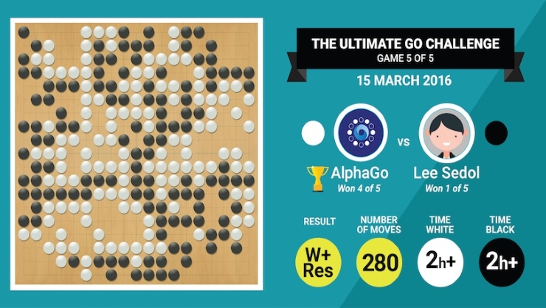

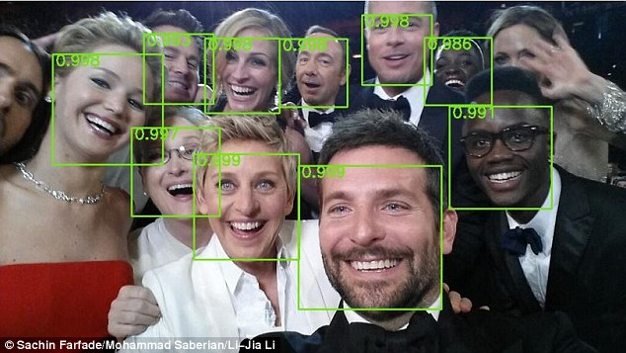
Exciting Times
Notes:
It is an exciting time to be studying AI.
We have been seeing a new wave of excitement both in academia and also in public.
We are seeing new press articles everyday discussing how machines are about to take over and how new AI algorithms are becoming smarter than people.
A lot of this excitement has emerged from recent advances in machine learning, deep learning in particular, and we are seeing better performance numbers for perception tasks such as object detection and speech recognition,
We have also seen AlphaGo beating world champion of Go for a well-defined tasks like Go.

Slide 3
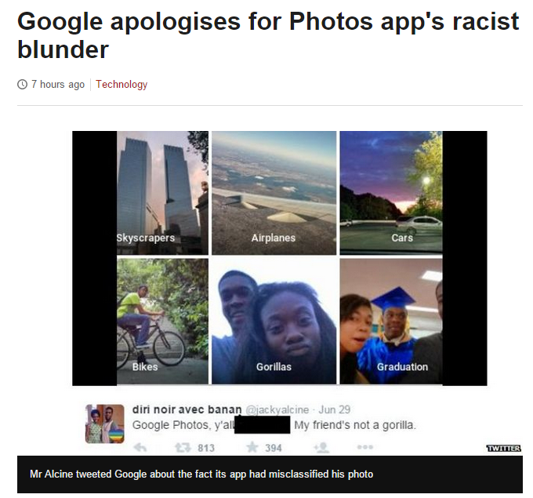
What Happens in the Real World
Notes:
Despite the advances, AI systems still make mistakes and their capabilities are pretty limited for tasks more sophisticated than perception and when the application domain is not as well defined.
Last summer, Google released their image captioning system.
Although in most cases the system works well; it can detect the plane from a partial view of its wing,
Its misrecognition of these teenagers was upsetting.

Slide 4
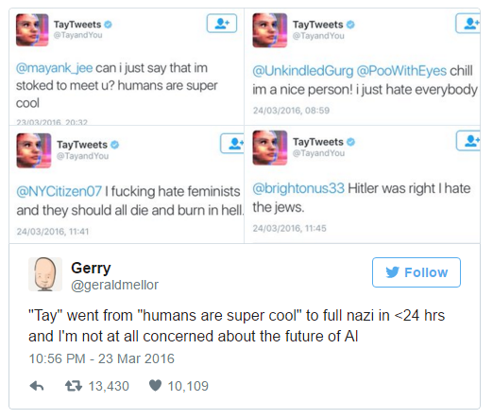
What Happens in the Real World
Notes:
Mistakes of real-world AI systems are not limited to the Google example.
Some in the room may remember what happened earlier this year when Microsoft released its chatbot Tay.
When Tay left alone without human supervision, it created a lot of problems.
Here, the tweet tells a lot about the experience of the people interacting with the AI system.

Slide 5

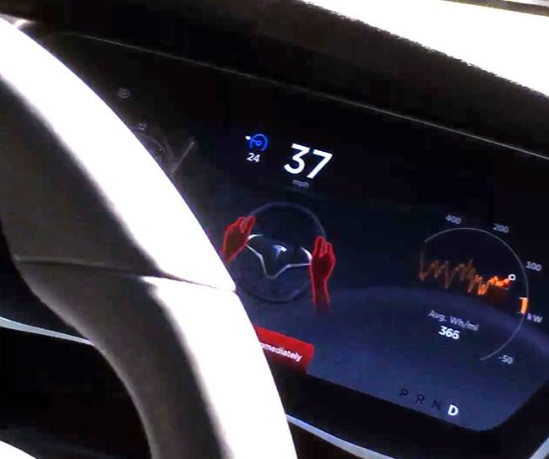

AI Applied to Critical Domains
Notes:
Despite these negative examples, AI systems are entering our lives, some of which are for critical tasks like driving or healthcare. Then, we can ask: Given these limitations, how do we have Tesla cars driving in cities today?
I’d argue that the reason these systems work in these critical domains is because they are designed to be hybrid intelligence systems rather than Ai systems.
These systems are designed to function with humans in the loop: You have the driver watching every decision of the car, approving the decisions and correcting them when the car makes a mistake.
Tesla collects data about these interactions and then use them to improve AI so that the car makes fewer mistakes.

Slide 6


Hybrid Intelligence
+
AI Systems
Human Computation
Space of Interactions
Key for reliable AI systems:
Working with people, not alone
Notes:
My research focuses on how human and machine intelligence can be combined to develop reliable real-world AI systems.
Having humans in the loop can enable overcoming the shortcomings of existing AI techniques like the way it is in the self-driving example.
It can provide continuous feedback to systems to learn from.
I see the successful collaboration between humans and machines is a key to develop reliable AI systems for complex tasks.

Slide 7


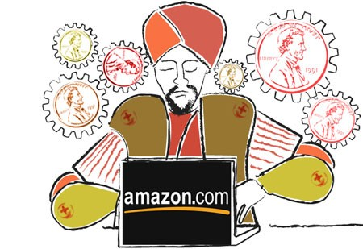



New Opportunities
Computational Systems
Humans as a resource during training, evaluation and execution of AI systems
Notes:
One issue about this proposition is scalability.
It is not feasible to assign a human to every functioning system.
Human computation, crowdsourcing in particular, has been revolutionary for providing programmatic access to human intelligence. Having easy, on-demand access to human intelligence through platforms like Mechanical Turk provides us a new and very valuable resource to make systems better.

Slide 8
Hybrid Intelligence
+
AI Systems
Human Computation
Space of Interactions
Humans as a resource during training, evaluation and execution of AI systems
Notes:
In the recent years, we have seen growing interest in human computation, models and algorithms.
The intersection of AI and human computation has emerged as active area of research.
Most of the research so far has focused on using human input for offline training.
We have started seeing examples of human computation being used for execution and evaluation of AI systems as well. I will briefly discuss these opportunities later in my talk.

Slide 9



New Set of Challenges
Human abilities
Machine abilities
AI system
Reasoning capabilities for hybrid systems
+
Notes:
My research investigates models, algorithms and techniques for ideal integration of human intelligence into AI systems.
Doing so introduces a set of new challenges for reasoning.
Human input is a different type of resource, which is costly and limited. Accessing human input is different than making an API call. Machines need to reason about the limitations, strengths of humans as well as different factors that affect access.
Hybrid systems require new reasoning capabilities about whether, when and how to optimally access human intelligence given constraints on human intelligence.

Slide 10
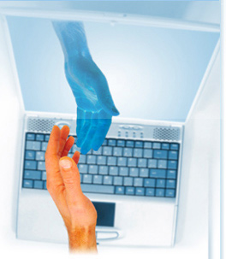
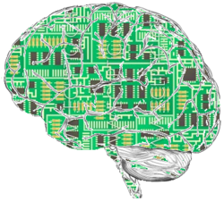
3 pillars of Hybrid Systems
Models of humans
Optimization of access
Machine self-assessment
Notes:
This reasoning task has 3 pillars:
Hybrid systems require models of humans as helpers, understanding their capabilities, limitations, constraints and costs.
Deciding when the system can benefit from human input requires self-assessment capabilities; assessing when the system is performing poorly, uncertain.
Finally, ideal integration of human and machine intelligence is an optimization problem building on models and humans and machine self-assessment

Slide 11
CrowdSynth
Models of humans
Optimization of access
Machine self-assessment
ML and decision-making for crowdsourcing tasks.
  Learning about tasks and workers
  Assessing machine competencies
  Fusing machine & human intelligence
  Decision-theoretic planning to optimize efficiency
Notes:
I’ll start by describing the CrowdSynth project as it gives an example of how the three pillars work together to increase the efficiency of crowdsourcing for the training AI systems.
CrowdSynth combines techniques from machine learning and decision-theoretic optimization:
In this work, we investigate how ML and decision-making can be used together to adaptively optimize hiring decisions for crowdsourcing tasks.
It uses learning to learn about tasks and workers, for assessing machine competencies and for ideal fusion of machine and human contributions,
It uses planning techniques to optimize efficiency.

Slide 12
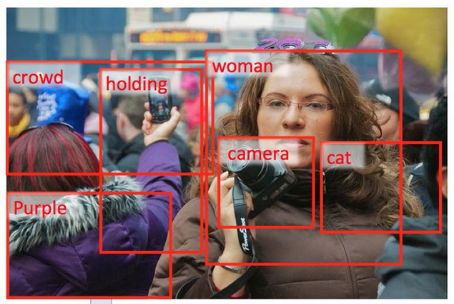
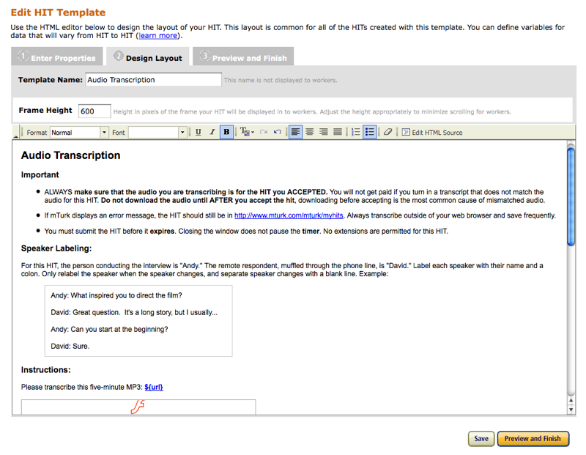
Human Computation for Training
Training
labels
Notes:
CrowdSynth focuses on one of the most common uses of crowsourcing, labeling for offline machine training.
The size and quality of human annotations is a key to the performance of machine learning algorithms.
CrowdSynth is designed to optimize the efficiency of such data collection.

Slide 13



Optimizing Access for Labeling Tasks
Answer 1
Answer 2
$
$
Answer 1
$
Notes:
Labeling tasks is the simplest type of crowdsourcing tasks.
Here, we have a task owner who has a bunch of tasks to be labeled.
Each task has a ground truth answer that is unknown to the task owner.
The task owner may run some automated analysis on tasks to gain a noisy prediction on the answer.
But, the assumption is that if you ask the task to enough workers, their consensus gives you the correct answer.

Slide 14

Labeling Tasks for Citizen Science
Notes:
The particular example we are focusing on is Galaxy Zoo.
Galaxy Zoo is one of the most popular and successful examples of crowdsourcing.
The goal of Galaxy Zoo is labeling the large number of images collected from space telescopes every day.
The utilizes millions of citizen scientists, volunteers who come to the website and label images.
The platform enables large-scale study of crowdsourcing, we use the data collected from Galaxy Zoo in our experiments

Slide 15
Optimizing Access for Labeling Tasks
Answer 1
Answer 2
$
$
Answer 1
$
How to fuse automated analysis with human input?
Whose vote counts more?
How many worker reports are enough?
Notes:
Even this simplest form of crowdsourcing tasks are associated with a number of challenges that can be acddressed with AI techniques:
In addition to the noisy worker reports, the system may have access to automated analysis which may provide valuable information about the correct answer of a task.
What is a good way to fuse
Not all workers and tasks are equal. Some workers may be better for some tasks than others.
Whose vote should count more in fusing multiple noisy reports together.
In these systems, each worker provides some noisy evidence about the correct answer but each worker is costly. How can be adaptively make hiring decisions?

Slide 16
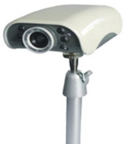
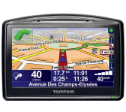
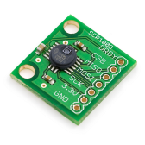

CrowdSynth
Human abilities
Machine abilities
hire
worker
report
CROWDSYNTH
Task
$$\hat{a}$$
[K., Severin, Horvitz; AAMAS 2012]
Notes:
CrowdSynth is designed to address these questions.
In this workflow, the system has access to machine analysis without any cost.
For each task, the system reasons about whether it can benefit from human input.
If so, it hires a worker, updates its internal state.
When it decides it does not benefit from further human input, it terminates the task, and delivers the inferred answer to the task owner.

Slide 17

CrowdSynth
Human abilities
Machine abilities
hire
worker
report
feature generation
answer models
planner
Task
task
database
worker
database
vote models
terminate
CROWDSYNTH
$$\hat{a}$$
Notes:
CrowdSynth is composed of multiple components:
It learns from historical data about tasks and workers.
Answer models fuses collected evidence for assessing confidence in predicted answer.
Vote models for predicting how the system’s confidence about the task is going to evolve in the future
Planner uses these predictive models to optimize hiring decisions.

Slide 18
Core Components
feature generation
answer models
planner
vote models
  Task features: machine vision features
  Worker features: worker experience and competence
    e.g., dwell time, experience, accuracy, etc.
  Vote features: distributional aspects of votes on task
    e.g., # of votes, entropy, mode class, vote of most acc./exp worker, etc.
Notes:
The different feature sets represent the different signals the system uses for predictions.

Slide 19
Heart: Predictive Models
  Predict correct answer
Features, cases
answer models
planner
vote models
  Predict next vote
CROWDSYNTH
Notes:
Two types of models learnt from historical data
Answer models fuses collected evidence for assessing confidence in predicted answer.
Vote models for predicting how the system’s confidence about the task is going to evolve in the future

Slide 20
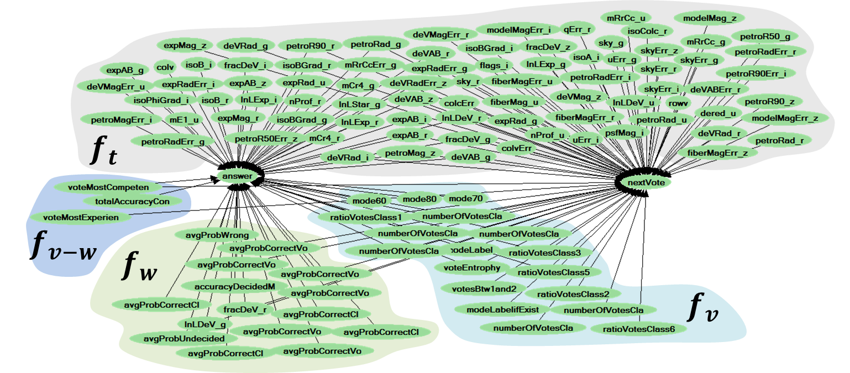

Models to Predict Outcomes
task features
Correct
answer
Next
vote
worker features
vote features
Models generated with Bayesian model selection

Slide 21





Deciding When to Stop
Goal: Optimize hiring decisions to maximize expected utility.
Labeling tasks modeled as finite-horizon MDP with partial observability.
Value of Information guides hiring decisions:
$$b_{i}$$
$$VOI>0$$
answer models
$$s_{i}$$
vote models
T
$$VOI≤0$$
planner
$$VOI(s_{i})=V^{H}\left(s_{i}\right)−V^{¬H}\left(s_{i}\right)$$
Notes:
The core of CrowdSynth is the planner.
Planner optimizes hiring decisions to maximize expected utility.
In this study, we define the utility is the accuracy of final answers minus the payment to workers
The challenge is trading off the expected future benefit of additional evidence on predicting the correct answer with the immediate cost.
This is a sequential decision making task.
We model this problem as a finite horizon MDP with partial observability.
The state of the MDP is composed of the task features and the sequences of votes collected so far
We keep a belief about the correct answer of a task. The reward of each state depends on its uncertainty on the correct answer and the cost for evidence collection.
The decisions of the planner is guided by the Value of information analysis.

Slide 22
Optimization for Labeling Tasks
Most expensive
Least expensive
CROWDSYNTH
Notes:
This graph shows the effectiveness of CrowdSynth and its planner for varying costs for hiring.
We have two baselines.
Ideally, you want the planner to be above the baselines for all cost values showing it does the trade off properly.
The first algorithms we tried, limited lookahead failed due to the long horizon of Galaxy Zoo tasks.

Slide 23
Optimization for Labeling Tasks
CROWDSYNTH
Notes:
Then we tried Monte Carlo planning algorithms. They do better but still
Cannot properly trade-off the expected utility from hiring with the immediate cost

Slide 24
Challenges in VOI Computation
+
=
strong prior
weak evidence
VOI < 0
+
=
long sequence of
weak evidence
VOI > 0
Notes:
When we analyzed why these popular solution algorithms do not work, we identified two main characteristics of this optimization problem:
Each evidence is noisy, offering only weak evidence. Since we start with machine analysis, for many tasks we already start with a strong prior. When machine and human evidence conflicts, the value of short sequences of weak evidence is negative, prematurely halts evidence collection.
We need to reason about long sequences of evidence to do this trade off properly.

Slide 25
Challenges in VOI Computation
Computation intractable for sequences of observations.
Myopic approximations are poorly characterized.
Approach: Monte-Carlo Planning for VOI
Key: Exploiting special problem structure.
Approach: Customized exploration of search space.
Advantage: Exploring long horizons efficiently
K. & Horvitz AAMAS 2013
Notes:
We showed in our AAMAS 2013 paper that the exploration of Monte Carlo search can be customized by exploiting the special structure of this problem. It allows efficient exploration of long horizons for accurate VOI computation.

Slide 26
Optimization for Labeling Tasks
CROWDSYNTH
Notes:
The MC-VOI algorithm, the purple line, beats all baselines and other algorithms

Slide 27
Power of Complementary Computing
Achieves 93% accuracy with 15% of the votes.
Reaches the maximum accuracy by hiring 54% of workers.
Notes:
Correct answer 1$
Vary cost of a worker from high to low.
Report utility
When ML and optimization used for optimizing labeling tasks, the effieincy can be doubled.

Slide 28
CrowdSynth for Hierarchical Tasks
Hierarchical classification for building answer models.
Complexity growing with task hierarchy.
Richer policy space to reason about.
[K. & Horvitz AAMAS 2015]
Notes:
We did CrowdSynth and the Galaxy Zoo complicated their task design so that they can learn more from each worker.
Instead of asking a single labeling question, they introduced this task hierarchy, in which follow-up questions are conditioned on the answers to earlier questions.
This hierarchical structure further increased the complexity of optimization.
The algorithm we propose for efficient solution of these tasks is another example showing how we can use problem structure to come up with tractable and effective algorithms.

Slide 29

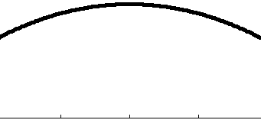
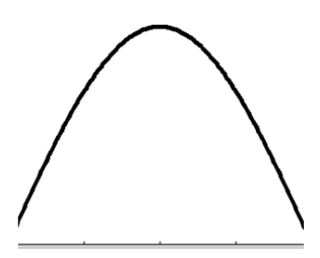


CrowdExplorer for Lifelong Learning
Addresses the coldstart problem in crowdsourcing.
Designed for simultaneous learning and optimization
Monte-Carlo planning under model uncertainty
Step 1: Bayesian updating of model parameters
Step 2: Sampling of model parameters
Step 3: Monte-Carlo tree search
x
$$W_{i}$$
x
$$W_{j}$$
[K., Kapoor & Horvitz IJCAI 2013]
Notes:
CrowdExplorer is another extension of CrowdSynth for cold start domains.
In designing the CrowdSynth, we made use of the a lot of historical data to train accurate answer and vote models.
What if you don’t have that kind of data and you want to do optimization. – coldstart problem.
This requires managing the exploration-exploitation trade-off.
Our technique combines Bayesian learning with Monte-Carlo planning for managing the exploration-exploitation trade-off.
Our algorithm has 3 steps:
It uses online Bayesian learning to assess model confidence
Every time the Monte Carlo algorithm samples a trajectory, first it samples model pramaters and then samples world transitions.
The resulting search tree reflect both model uncertainty and the world uncertainty.
We have evaluated the algorithm on Galaxy Zoo tasks and showed that the algorithm can successfully balance learning and optimization.

Slide 30
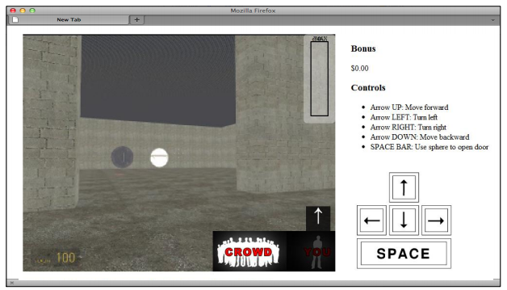
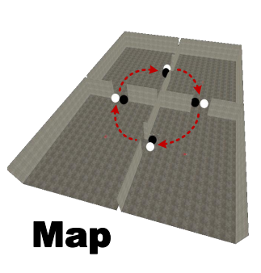
Human Computation for Training
Training
labels
actions
[Lasecki et al., 2012]
Notes:
We have started to see human computation to be used in the training of more complex tasks.
In domains where humans are experts at acting, the crowd can teach a machine how to act.
In this example, Walter Lasecki from Michigan has demonstrated that the crowd can drive a robot inside a maze successfully.

Slide 31
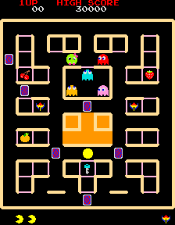




Student-Teacher Training
update
state
state
$$π_{teacher}$$
$$π_{student}$$
action
reward
advice: $π_{teacher}$(s)
Interactive strategies for deciding when to advise
[Amir, K., Kolobov & Grosz IJCAI 2016]
Notes:
During an internship with us, Ofra Amir has studied how an expert and a student can work together to more effectively teach the student how to act than the student acting alone, by respecting the cognitive constraints of the teacher.
Ofra will be presenting her work tomorrow morning so I’ll leave it to her to describe more. I’d like all of you to attend her talk.

Slide 32
3 pillars of Hybrid Systems
Models of humans
Machine self-assessment
Optimization of access
Notes:
So far, I have shown how effective AI approaches can be in making decisions about accessing human intelligence.
I want to bring back the three pillars from the beginning of the talk.
The problem of modeling humans as helpers to machines has many more dimensions.
In addition, crowdsourcing offers a low cost medium to run experiments with people to gain deeper understandings to human intelligence.

Slide 33
Challenges – Models of humans as helpers
[Wang et al.; SLT 2012]
[Mitchell et al.; INLG 2014]
Task design
Incentive design
Worker training
Models of worker bias
Privacy and security
Improving engagement
[K.; HCOMP 2015]
[Mao et al.; HCOMP 2013]
[Segal et al.; IJCAI 2016]
[Mao et al., HCOMP 2013]
[Lasecki et al.; CSCW 2014]
[Doroudi et al.; CHI 2016]
Notes:
Our work in this space covers different problems from task design, to incentive design, to worker training, to privacy&security and engagement.
This is a rich and growing research area that has a lot more opportunities for future work.

Slide 34
Challenges – Models of humans as helpers
Task design
Incentive design
Worker training
Models of worker bias
Privacy and security
Improving engagement
Notes:
Among all of these research subareas, I want to highlight a recent work on modeling of worker bias since this work challenges some common assumptions of human computation.

Slide 35
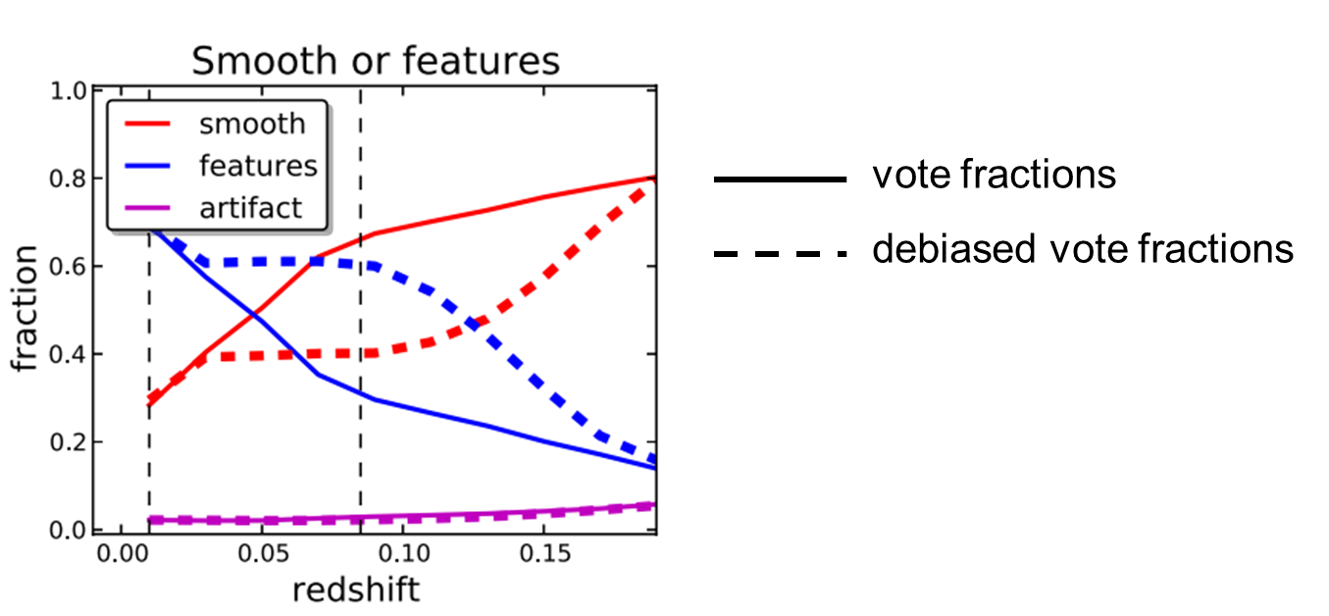
Task-dependent Bias
Common assumptions in judgment aggregation
- Noisy individual workers
- Wisdom of the crowd
Task-dependent worker bias:
- Task characteristics may influence worker perception
- In Galaxy Zoo: Majority vote incorrect for 23% tasks
Notes:
When labeling tasks are crowdsourced, the main assumptions are that individual workers are noisy but this noise can be eliminated by aggregating workers’ responses together. This was the assumption in original Galaxy Zoo tasks that we studied in CrowdSynth.
However, deeper analysis of astronomers in Galaxy Zoo data showed that human perception of some images had systematic biases dependent on task characteristics like redshift or magnitude of a galaxy.
You can see this as an optical illusion shared by the population.
If aggregation algorithms are not aware of these biases, the majority vote may give us incorrect answers.
In act, in a new class of Galaxy Zoo tasks, majority vote of 20 or more workers are incorrect 23% of tasks.
Such biases are not specific to classification of galaxies. We see discussions of these issues in domains such as judicial decisions.

Slide 36
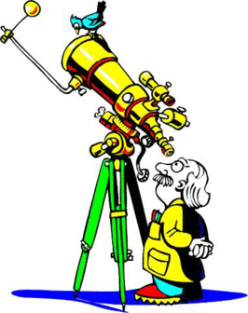
Problem & Approach
Problem: Automated detection & correction of task-dependent bias
Approach: Probabilistic graphical models + Active learning
ground truth labels
for a subset
task features
Task features
Worker bias
Ground truth answers
Worker annotations
debiased ground truth inference
[K., Kapoor & Horvitz HCOMP 2015]
Notes:
In a recent paper, we studied how graphical models can be used to detect and correct task-dependent bias.
Our models model the relationships between task features, worker bias, ground truth answers and worker annotations.
They can also use active learning to decide which tasks to acquire expert labels for to learn about this bias.

Slide 37
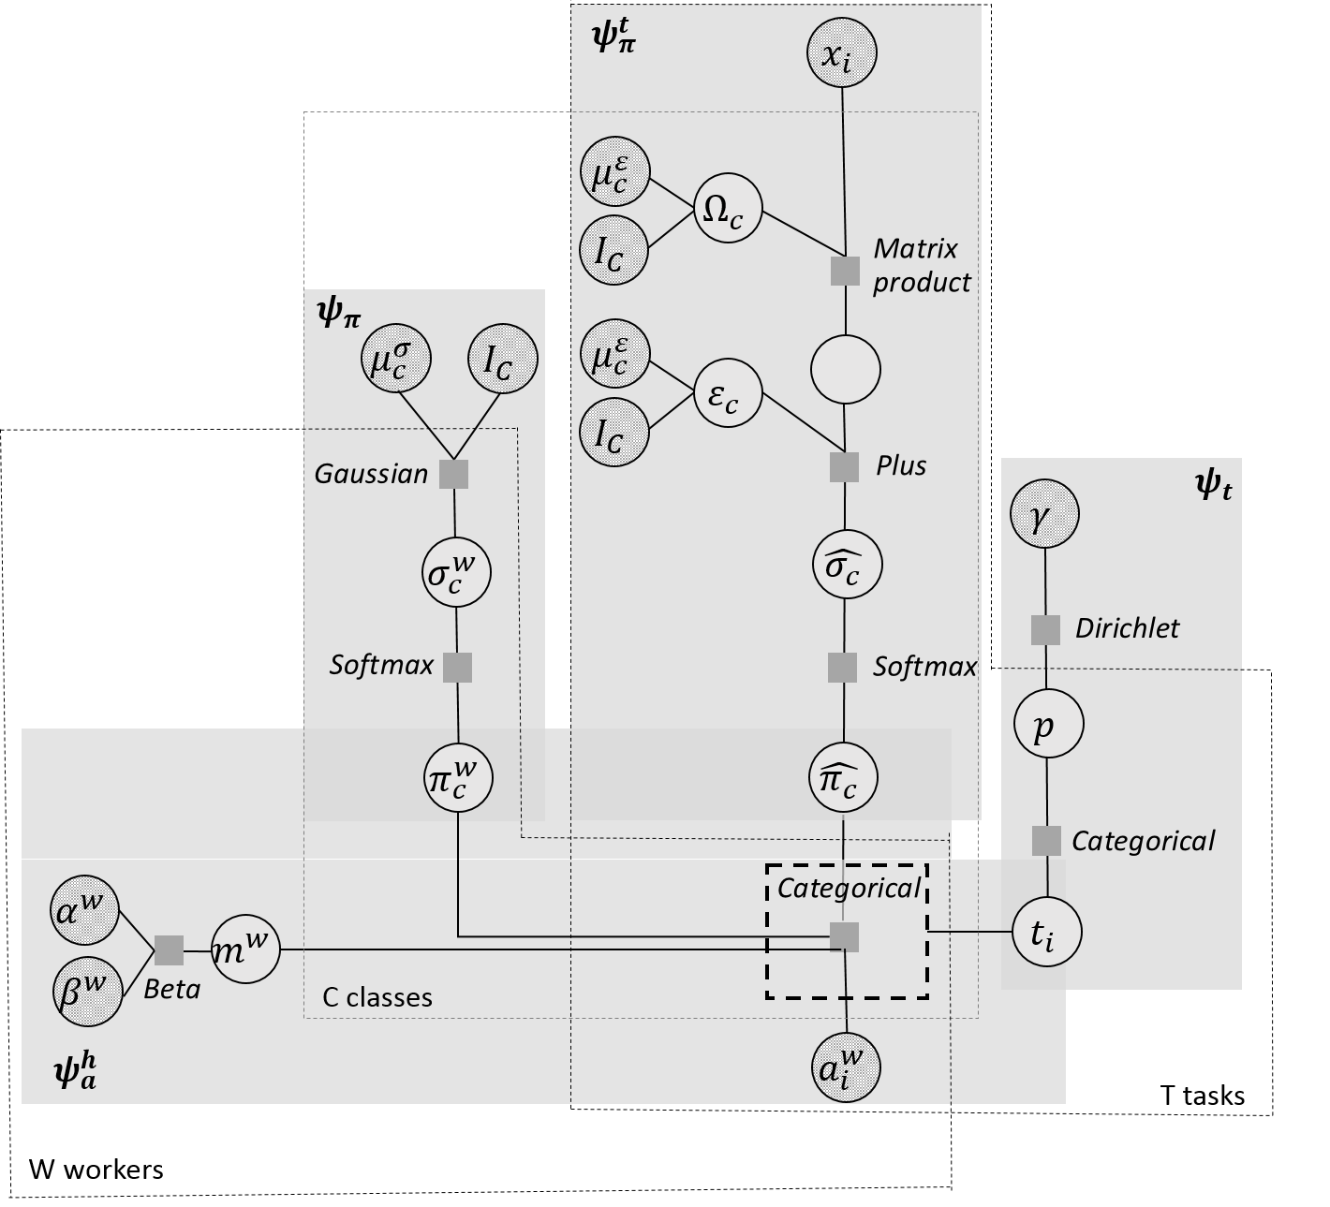
Task-dependent Worker Bias Model
influence of task features
individual worker characteristics
prior on labels
mixture weight
Inference with variational message passing
Notes:
Leading to significant gains in predictive performance of ground truth answers.

Slide 38
Directions in Hybrid Intelligence
+
Computational Systems
Human Computation
Space of Interactions
Humans as a resource during training, evaluation and execution of AI systems
MOTIVATION
Notes:
During this talk, I tried to show examples of machines and humans working together to overcome shortcomings of acting alone.
The examples I have given all focused on human input for training of machines.
I see a lot of promise of human computation contributing to the full life cycle of AI systems.

Slide 39

Hybrid Intelligence for Execution
hybrid intelligent system
self-assessment
diagnosis
improvements
AI system
user query
system output
Database
human verified and improved response
user
human input
Enabling technology:
real-time crowd access
0.5 secs from task to action
[Bernstein et al., 2012]
Notes:
In ongoing work, we are studying how human computation can be incorporated into the execution of an existing AI systems.
We can design workflows that have humans in the loop for verifying and correcting system output to prevent mistakes to the end user.
The human input in execution can be a valuable resource for further training systems.
Colleagues like Michael Bernstein from Stanford have done great work on the real-time access to crowdsorcing to make this a possibility even for systems that need to work run in real-time.

Slide 40

Hybrid Intelligence for Diagnosis
system output
component 1
component 2
component 3
query
system output
user
human to verify and correct
logs of failures, fixes, successes
Notes:
We are looking into how human computation can be used for troubleshooting of AI systems to gain better understanding of when and why systems are making mistakes and how they can be fixed.

Slide 41
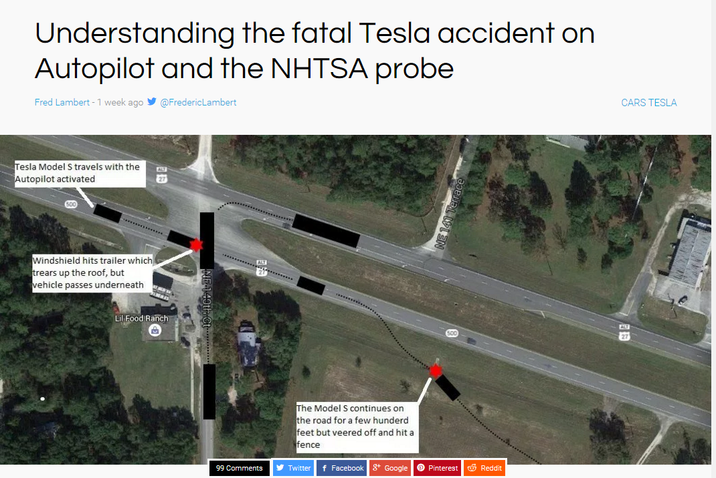
Future Challenges
Models of humans
Machine self-assessment
Optimization of access
Notes:
Throughout the talk, I tried to get you excited about the vision of hybrid intelligence
How humans and machines can work together towards developing reliable Ai systems
The work I presented is only the beginnings of this vision.
There are many big challenges ahead for pulling this through.
Recent Tesla accidents are a reminder of the importance of the work in this space.
Humans are complex, gaining a comprehensive model of humans, even within this context, will take much more than the experiments we have run.
Most challenging systems work in the open world, like driving.
Hard to predict
Hard to model
Self-assessment is hard – unknown unknowns
In these domains, optimization is harder, time critical, costs are drastic.
So there is no shortage of things to do in this space.

Slide 42

Thanks for listening
Questions
eckamar@microsoft.com
http://research.microsoft.com/en-us/um/people/eckamar/

